Slide 1
Lecture-5 Row/Column Major order for Address Calculation
Prepared By:
Afsana Begum
Lecturer,
Software Engineering Department,
Daffodil International University.

Slide 2
Objective
Find out the Address of an element of Array

Slide 3
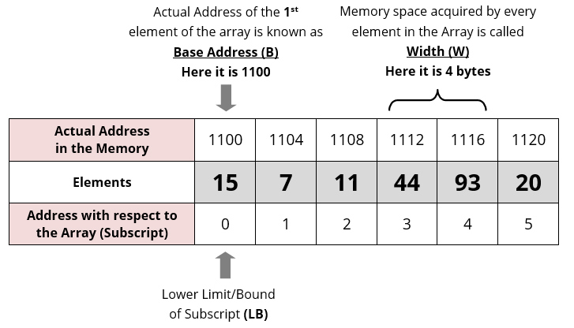
Address Calculation in single Dimension Array

Slide 4
Address Calculation in single Dimension Array
Array of an element of an array say “A[ I ]” is calculated using the following formula:
Address of A [ I ] = B + W * ( I – LB )
Where, B = Base address W = Storage Size of one element stored in the array (in byte) I = Subscript/Index of element whose address is to be found LB = Lower limit / Lower Bound (Value) of subscript/index, if not specified assume 0 (zero)

Slide 5
Address Calculation in single Dimension Array
A [ I ] = B + W * ( I – LB )
Array[3]=44
Addres=A[3]=1100+4(3-0)=1112 ans.

Slide 6
Address Calculation in single Dimension Array
Example:
Given the base address of an array B[13,14,15,16,17,18,19] as 1020 and size of each element is 2 bytes in the memory. Find the address of B[4] or 17.

Slide 7
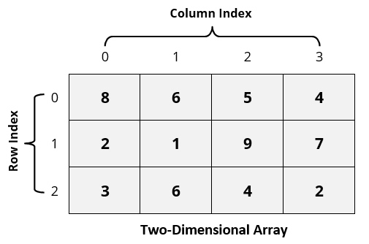
Address Calculation in Double Dimensional Array

Slide 8
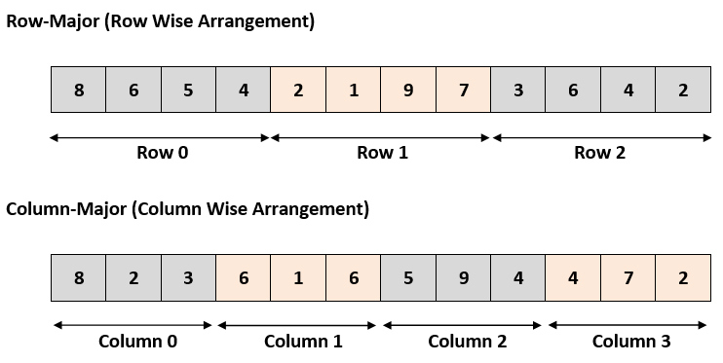
Address Calculation in Double Dimensional Array

Slide 9
Address Calculation in Double Dimensional Array
Row Major System:
B + W * [ N * ( I – Lr ) + ( J – Lc ) ]
Column Major System:
B + W * [( I – Lr ) + M * ( J – Lc )]
Where, B = Base address I = Row subscript of element whose address is to be found J = Column subscript of element whose address is to be found W = Storage Size of one element stored in the array (in byte) Lr = Lower limit of row/start row index of matrix, if not given assume 0 (zero) Lc = Lower limit of column/start column index of matrix, if not given assume 0 (zero) M = Number of row of the given matrix N = Number of column of the given matrix

Slide 10
Sizes of Fundamental Types (w)
Type | Size
bool, char, unsigned char | 1 byte
short, unsigned short | 2 bytes
float, int, unsigned int | 4 bytes
Double, long double | 8 bytes
____int128 | 16 bytes

Slide 11
Problem 1
Suppose element of array A[4][5] occupies 4 bytes, and the address of the 1st element is 49. Find the address of the element A(4,3) when the storage is row major.

Slide 12
Solution
49 + [5 * (4 – 0) + (3 - 0)] * 4
=49 + [23] * 4
=49 + 92
=141

Slide 13
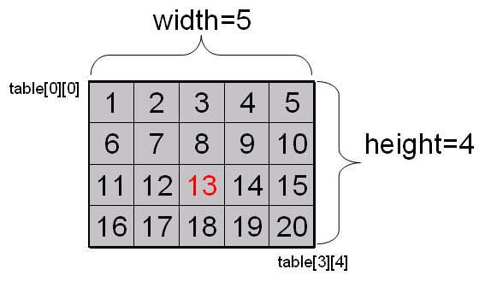
Problem 2
Calculate the address of Array element “13” of 2-D float type array.
Where base address of Array matrix is 3333 and follow the
column-major-order procedure

Slide 14
Problem 3
Calculate the address of Array [2][3] elements of 2-D float type array. Where base address of Array matrix is 1000 and follow the row-major-order procedure.
6.5 | 5.3 | 9.4 | 4.1
9.7 | 5.6 | 4.2 | 5.0
6.3 | 7.1 | 7.3 | 9.4

Slide 15
Question?

